Slide 1
Labor Rights and Remedies under Globalization
Janice R. Bellace
Wharton School, University of Pennsylvania
May 11, 2022 Toronto
National Academy of Arbitrators – International Studies Committee

Slide 2
1970s - first efforts to regulate corporate behavior
Move to compel MNCs to abide by “national law and practice”
re generally accepted principles of workers’ rights
Resort to supranational bodies to set this expectation
1976 OECD Guidelines for Multinational Corporations
1977 ILO Tripartite Declaration of Principles concerning
Multinational Companies
1976 UN Commission and the Centre on Transnational
Corporations
Soft Law statements termed “guidelines” or “codes of practice”
Notes:
Huge change. Nike – Phil Knight quoted in the early 1990s saying Nike was not responsible for what occurred in the factories as they were not Nike factories.

Slide 3
1992 NAFTA controversy
Free trade opponents support “fair trade” not free trade
What is “fair trade”? Worker rights are respected.
Solution: insert a “labor clause” in FTAs saying signatory nations
must ensure observance of worker rights.
What rights? What do they mean?

Slide 4
Accepting liberalized trade
How to ➢ Get employers to abide by fundamental labor rights
Problem:
Any employer who did so would not be able to compete -- unless all employers do so
Solution: national legislation aligned with international standards
but
International standards must be defined with precision
and must be “respected”
WHO can compel this to happen?

Slide 5
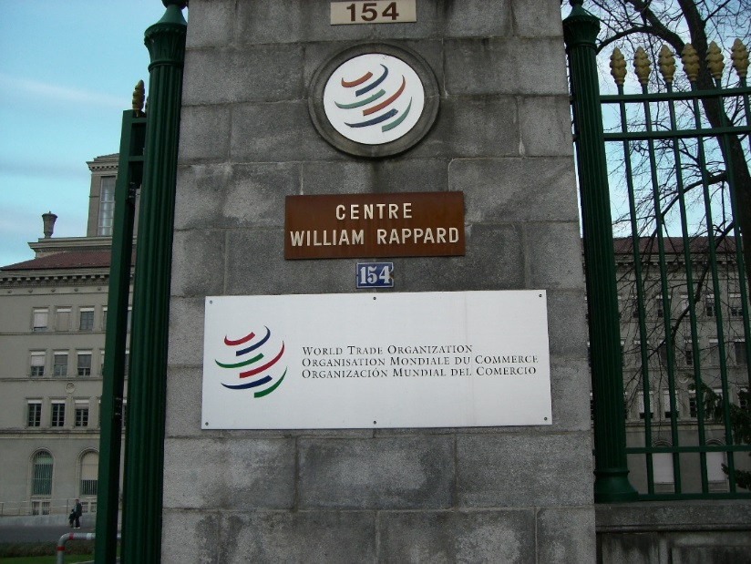
1990s Globalization
Emergence of global retailers and
“brands” in low wage industries
e.g., Nike, Walmart, H&M
→ Buyers of products are not the employer of the workers.
Not covered by national labor laws
Do not feel responsible for labor conditions at suppliers’ factories
NGOs focus on abusive working conditions of those in the global supply chain and often target the buyers of the products.
Notes:
Huge change. Nike – Phil Knight quoted in the early 1990s saying Nike was not responsible for what occurred in the factories as they were not Nike factories.

Slide 6
Globalization
1990s globalization
Companies sourcing worldwide
technological change / faster, cheaper communication
Many companies now focus on buying products in other in countries another country rather than making the product
themselves
Trade rounds / NAFTA 1993
1995 WTO established

Slide 7
WTO Opts Out
Drive to have WTO consider a country’s worker rights record before granting preferred trading status
WTO says ILO is “competent body to set and deal with these standards”
December 1996 Singapore Ministerial meeting
ILO confronts issue of imposing its standards on those active in the global supply chain (not limited to “employers”)
Notes:
This is new for the ILO. ILO conventions told countries to enact legislation (and enforce it) that would apply to employers in that country.

Slide 8
ILO extending its reach
ILO confronts issue of imposing its standards on those active in the global supply chain (not limited to “employers”)
ILO does not directly regulate employers (although many
conventions contemplate that employers will be affected)
Some countries have not ratified important conventions
Some countries lack the capacity to enforce laws
Notes:
This is new for the ILO. ILO conventions told countries to enact legislation (and enforce it) that would apply to employers in that country.

Slide 9
Identifying Rights at Work post-1990
1995 WTO established
1996 WTO opts out of worker rights debate
1998 ILO adopts a “Declaration of Fundamental Principles and
Rights at Work”
2000 UN Global Compact (uses above principles)
2011 UN Guiding Principles on Business and Human Rights

Slide 10
1998 ILO Declaration - Principles
freedom of association and the right to collective bargaining
the elimination of all forms of forced labour
the effective abolition of child labour
the elimination of discrimination in employment
Declaration applies to all members of the ILO
Four principles linked to 8 core conventions

Slide 11
ILO “Core Conventions “
Freedom of Association
C. 87 and C. 98
Abolition of Forced Labor
C. 29 and C. 105
Elimination of Child Labor
C. 138 and C. 182
Non-discrimination in employment
C. 100 and C. 111
GO Conventions elaborate on what the
principles mean

Slide 12
UN Global Compact
January 1999 Kofi Annan at Davos announces that there will be a global compact and urges “business” to align its operations with these principles
July 2000 UN Global Compact launched
Two general human rights principles
Four “labour” principles
Three environmental principles
Anti-corruption principles later added

Slide 13
UN Global Compact - Principles
freedom of association and the right to collective bargaining
elimination of forced labour
effective abolition of child labour
elimination of discrimination in employment
→ UNGC uses ILO Declaration’s 4 principles

Slide 14
Impact of 2000 UN Global Compact
Labor principles not expressly linked to core conventions
No mandatory coverage – a voluntary alignment by businesses
No supervision or monitoring
→ Thousands of companies sign the Global Compact
→ Corporate codes of conduct use Global Compact language

Slide 15
What Does the Company Code of Conduct Mean?
Using what standard
Support for general principle?
Adherence to meaning in ILO convention?
Complying with national law or practice ?
Committing to what form of enforcement
De-listing of vendor?
Discipline of errant managers?
Independent inspectors, independent auditors?
Notes:
National law may set a standard much lower than the ILO convention (and the law may not be enforced)

Slide 16
UN – Ruggie Principles 2011
UN Human Rights Council
June 2011 Report of the Special Representative of the Secretary-General on “the issue of human rights and TNCs and business enterprises”
Protect, Respect, Remedy framework
Part II: “Business enterprises should respect human rights.”
Notes:
This was being debated in the 1990s, started out as regulating TNCs, and then morphed. 2003 deadlock. 2005 Ruggie appointed. Took 6 years. BUT delay probably gave certain activists time to think about what was lacking in the UNGC, and to realize that fundamental principles w/o definitions are worthless

Slide 17
UN - Ruggie Principles 2011
“The responsibility of business enterprises to respect human rights refers to internationally recognized human rights – understood, at a minimum, as those expressed in the International Bill of Human Rights and the principles concerning fundamental rights set out in the ILO’s Declaration on Fundamental Principles and Rights at Work.”
Part II, para. 12

Slide 18
Can Private “Law” Implement the Protect, Respect and Remedy Framework?
Hurdles
Lack of agreement on specific standards among ALL players
Lack of private dispute resolution mechanisms utilizing ILO / UN definitions
Inability to “police” or enforce compliance / awards
National due diligence laws
Notes:
National law may set a standard much lower than the ILO convention (and the law may not be enforced)

