Slide 1
Pilot Scheduling Overview for NAA
Jeff Nooger
Sr. Scheduling & Work Rule Analyst,
Economic & Financial Analysis Dept. Air Line Pilots Association, International
May 3, 2023

Slide 2
Contract Sections Involving Scheduling
Section Titles differ based on the individual Contract
Definitions
Pay/Hours of Service
Minimum Guarantees
Deadheading
Staffing / Allocation, Assignment and Scheduling of Flying
Filling of Vacancies
Leaves / Leaves of Absence
Vacation
Crew Scheduling / Daily Operations / Reserve Assignments

Slide 3
Pay / Hours of Service
Pilot Pay Methods
Salary
Monthly set amount
May have overtime processes
Hourly with Credit
Most airlines hourly
Credit (by other names: synthetic/soft time)

Slide 4
Pay / Hours of Service (cont’d)
Scheduled versus Actual
Higher of Planned versus Actual flown by:
Legs / Segments
Day
Trip / Pairing / Rotation / Blocks / Pattern
Month

Slide 5
Pay / Hours of Service / Minimum Guarantees
Minimum Pay Guarantees (Line Holder, Reserve)
Monthly Guarantee / Line Guarantee / Bid Period
Minimum pay per month
Daily / Duty Period Guarantee
Minimum pay per day (example; 4 hours for each day on duty)
Minimum Days Off

Slide 6
Pay / Hours of Service / Additional Credit Hours
Hourly with Credit (Rigs)
Duty Rigs / Duty Pay (Credit / Time on Duty)
Start of duty to end of duty; each duty period
Minutes /Hours
example; 1 hour credit for 2 hours on duty (1:2)

Slide 7
Pay / Hours of Service / Additional Credit Hours (cont’d)
Hourly with Credit (Rigs) (cont’d)
Trip Rigs / Trip Ratios
Full trips time away from base including start of duty to end of duty
the number of minutes of pay and credit derived by dividing the greater of the scheduled or actual minutes during the trip hour period by the Trip Rig denominator
example; 1 hour credit for 3.5 hours of entire trip duty (1:3.5)

Slide 8
Pay / Hours of Service / Additional Credit Hours (cont’d)
Additional Pay or Various Pay Processes (Hourly or Hours per Day)
Night / WOCL
International
Premium Pay
Repositioning
Dead Head (DH) rules
Training (Hours per Day)
Vacation (Hours per Day)
Deviations / Reassignments
Sick List
Sometimes Pay no Credit!

Slide 9
Pay / Hours of Service
Hours of Service
Reserve (value of a day)
Long call, Short call, field standby
FARs / CARs / Contractual
Monthly and Yearly Maximum
On Duty and Rest
Dead Head
Duty Time Extensions
Notification and Contact

Slide 10
Staffing / Filling of Vacancies / Allocation, Assignment and Scheduling of Flying
Staffing
Flight Crew Planning
Base / Domicile Staffing
Opening & Closing new Positions
Vacancies and Displacements / System Bidding
Pay Protection
TDY
Rosters and Seniority Lists
Leaves / Leaves of Absence
Medical / Sick (SLOA), Military (MLOA), Family (FLMA), Company Offer (COLA), Personal

Slide 11
Staffing / Allocation, Assignment and Scheduling of Flying
Scheduling of Training (Recurrent / Transition)
Recurrent Training Bidding (RTB) and/or Assignment of Recurrent Training (6/12 - OR 9/18 - month process)
Prior to the monthly scheduling preferencing
Bidding or Assignment of Transition Training (change in equipment and / or seat)

Slide 12
Staffing / Allocation, Assignment and Scheduling of Flying
Vacation
Accrual
Timelines
Vacation dates or predetermined periods
Annual vacation bidding and Awarding Process
Monthly Vacation Bidding, Trading and Awarding Process
Close in Vacation Drops and Modifications

Slide 13
Staffing / Allocation, Assignment and Scheduling of Flying
Construction of Pairings / Trips / Blocks / Rotation-Building
FARs / Contract Rules / Buffers
Pay caps
Duty Rigs and Trip Rigs
Flight and Duty Limits
Buffers (extra time)
Company Optimizers used to reduce costs
Costs = Pay Credit, Layovers time / Hotels / DH
Versus ALPA desire for Quality of Life and Minimize Fatigue

Slide 14
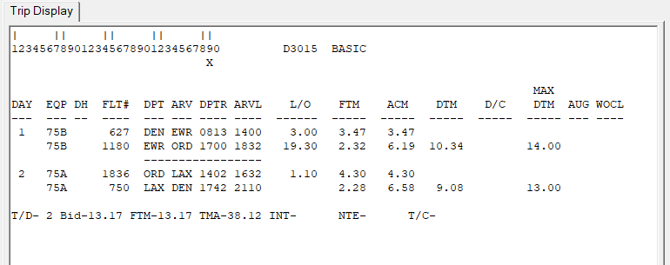
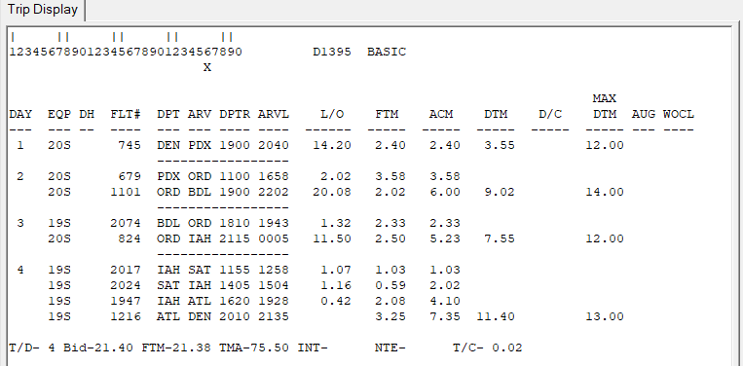
Staffing / Filling of Vacancies / Allocation, Assignment and Scheduling of Flying
Construction of Pairings Legs Optimized into Pairings

Slide 15
Staffing and Duty
Advancement in Fight Time Duty Time (FTDT) Rules (FAR 117)
Fatigue
Flight Duty Period (FDP)
Fatigue Review Committee / Board / Panel
Fatigue Risk Management System (FRMS)
FAR 117 Exemptions
Ultra-Long Haul (ULH) (over Prescribed FAR 117 Flight Duty Periods (FDP))
Other Operations outside prescribed FAR 117

Slide 16
Staffing / Allocation, Assignment and Scheduling of Flying
Monthly Bidding
Timelines
From segments to Live schedules
Bid Months / Blocks
Monthly
30 / 31 days
28-day Blocks
Sometimes 56 or 84 days

Slide 17
Staffing / Assignment and Scheduling of Flying
Monthly Schedule Bidding/Rostering (Line Construction and Bidding/Preferential Bidding System (PBS)
Line-holders / Reserves
Seniority based or fair share
Pilot preference bid
Award lines
Vacation, Training / IOE, Leaves, Sick List, etc..

Slide 18
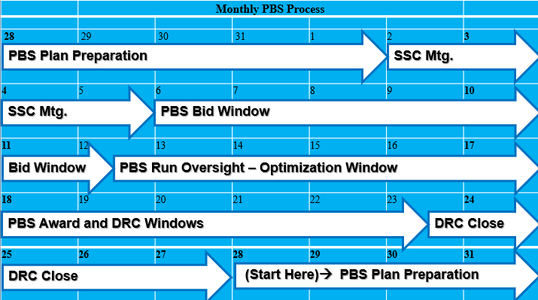
Staffing / Filling of Vacancies / Allocation, Assignment and Scheduling of Flying

Slide 19
Crew Scheduling / Daily Operations / Crew Desk (CD)
Reserve Assignments
Long Call / Short Call
Reserve Availability Periods (RAP)
Reserve Duty and Limits
Order of Assignment and Call Outs
Training and Line Operating Experience (LOE), Landing Currency

Slide 20
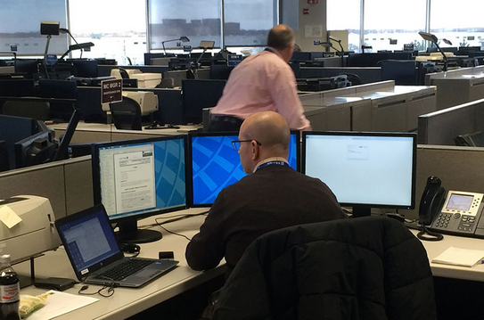
Crew Scheduling / Daily Operations / Crew Desk (CD)
Line Holder Reassignments / Deviations / Cancellations
Pay Discrepancies for Crew Desk Assignments and Reassignments
Process for pay resolutions

Slide 21
Crew Scheduling / Daily Operations / Crew Desk (CD)
Pilot Initiated Schedule Modification (Software Program or manually done with the CD)
Pilot to Pilot Trip Trades
Pilot Pickups / Drops / Trades

Slide 22
Questions?

