Slide 1
SPECIAL SESSION - HOW ARBITRATION IS HANDLED IN CAMBODIA
Time: 3pm-4:15pm
Speakers: Kong Phallack, You Suonty & Ann Vireak

Slide 2
CONTENTS
1
Introduction
4
5
Q&A
Cases Registered and solved at Arbitration Council
2
Regulating Labor Disputes Resolution and Types of Labor Disputes
3
Arbitration Council Procedures

Slide 3
INTRODUCTION
Government
Ministry of Labor and Vocational Training (MLVT)
Arbitration Council
Employer
CAMFEBA
Sectoral Association of different industries (13)
Union
Confederation (40)
Federation (267)
Local Union (5694)

Slide 4
Regulating Labor Disputes Resolution and Types of Labor Disputes
Regulating Labor Dispute Resolution
Labor Law (1997) Ch.12
Code of Civil Procedures (2006)
Prakas No. 099 (204) on Arbitration Council [Ref: Prakas No.338 (2002) on Arbitration Council]
Prakas No. 317 (2001) on Procedures of Collective Labor Disputes
Prakas No. 318 (2001) on Procedures of Individual Labor Disputes
Law on Trade Union (2016)
Law on Social Security (2019) [Ref: Law on Social Security (2002)]
4

Slide 5
Regulating Labor Disputes Resolution and Type of Labor Dispute
Types of Labor Dispute
Individual Labor Dispute (Article 300-New, Labor Law)
Collective Labor Dispute (Article 302, Labor Law)
5

Slide 6
Individual and Collective Labor Disputes Resolution
Individual Labor Dispute Resolution
Enterprise’s Grievance Complaint Procedures (Internal Regulation of the Enterprise, Employment Contract or Collective Bargaining Agreement)
Option 1: Voluntary Conciliation by Ministry in charge of Ministry of Labor
Option 2: Competent Court
Note: Recent Development and Discussion on role of Arbitration Council in Individual Labor Disputes
6

Slide 7
Individual Labor Dispute Resolution Procedures
Employer vs Worker (s)
Enterprise Level
Employer vs Worker (s)
Enterprise Level
Voluntary conciliation by Ministry of Labor
Court
Court
Option 1
Option 2
7

Slide 8
Individual and Collective Labor Disputes Resolution
Collective Labor Dispute Resolution
Enterprise’s Grievance Complaint Procedures (Internal Regulation of the Enterprise, Employment Contract or Collective Bargaining Agreement) if any
Compulsory Conciliation by Ministry in charge of Ministry of Labor
Compulsory Arbitration by Arbitration Council
Industrial Action (Strike and/ Lockout) and /or Competent Court
8

Slide 9
Collective Labor Dispute Resolution Procedures
Employer vs Workers
Enterprise Level
Conciliation
by Ministry of Labor
Arbitration
By Arbitration Council
Strike/Lockout
Court
9

Slide 10
Arbitration Council Procedures
About Arbitration Council
Tripartite body composed of 30 arbitrators (1/3 from the employer list, 1/3 from the Union list and 1/3 from the government list (2019)
Arbitration Council is supported by the Secretariat of Arbitration Council, an arm of the Ministry in charge of Labor and the Arbitration Council Foundation, a local NGO registered with the Ministry of Interior
Arbitrators are annually appointed by the Prakas of Ministry in charge of Labor
10

Slide 11
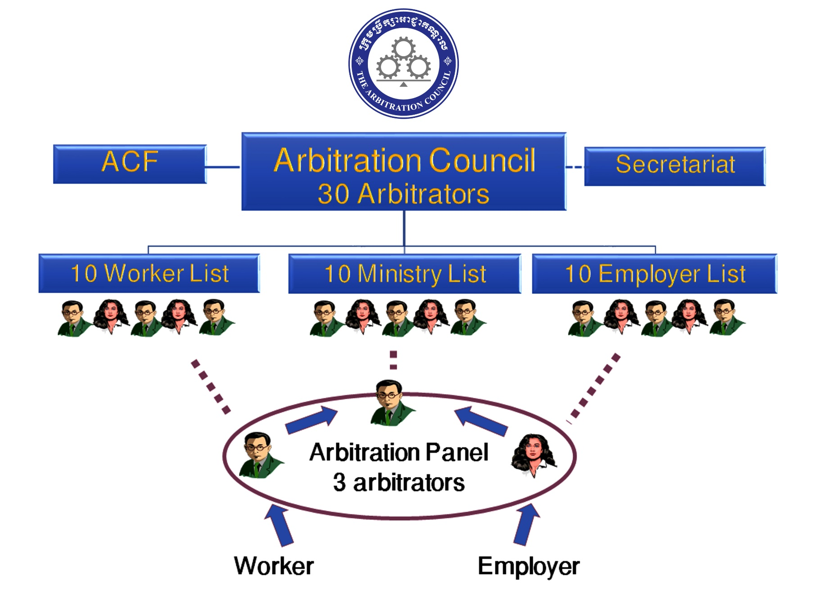
About Arbitration Council
The Arbitration Council
11

Slide 12
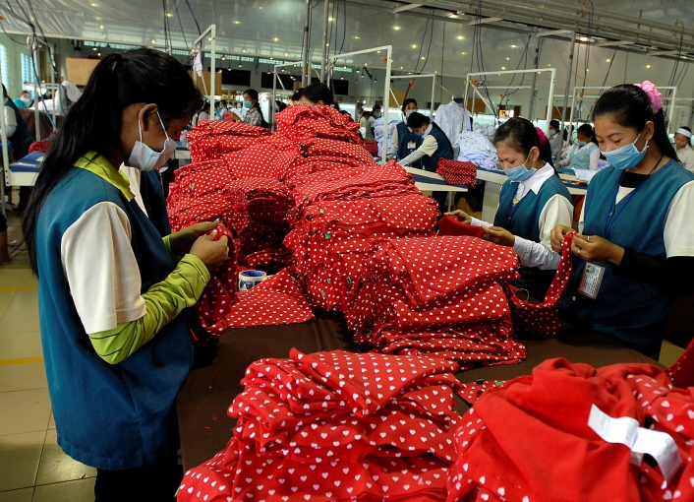
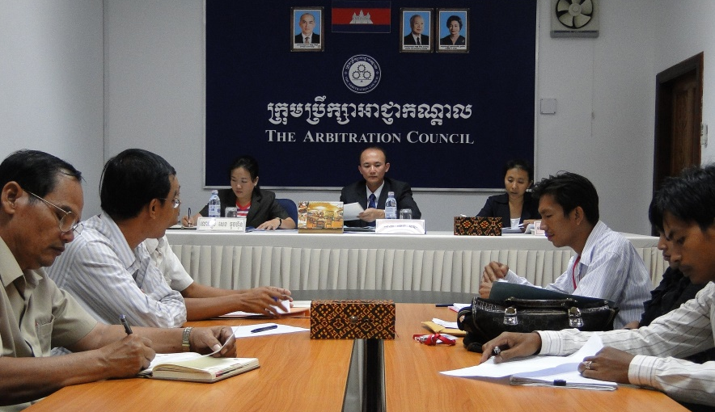
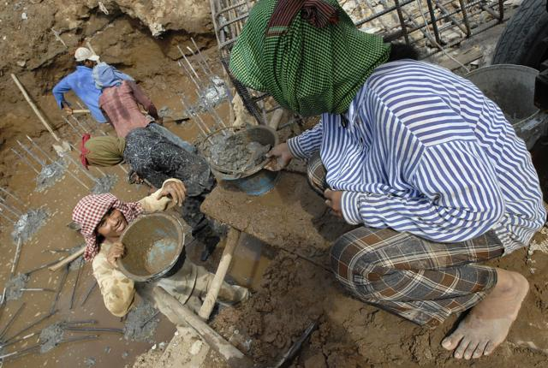
The Arbitration Council
About Arbitration Council
How it works? Why it was designed such a away?
Internal Factors: Labor Disputes and no trustable mechanism
External Factors: Cambodia-US Bilateral trade Agreement, ILO
12

Slide 13
The Arbitration Council (Con’t)
Summary of Labor Dispute Resolution Procedures
Disputes
C
O
O
L
I
N
G
-
O
F
F
Individual
Collective
Voluntary conciliation by Ministry of Labor
Compulsory conciliation by Ministry of Labour
Compulsory resolution by Arbitration Council
Court
Rights
Interest
Court
Strike/ Lockout
13

Slide 14
Arbitration Council Procedures
Arbitration Council Procedures
Before Hearing, Hearing and Post Hearing
Before Hearing: The Minister in charge of labor refers the case to Arbitration Council, case registration, Choose Arbitrators, Forming Arbitration Panel, and Setting the Hearing dates, Invitation sent to party notifying the hearing and submission of evidence
Hearing: Explaining Procedures, choosing arbitral award, and conducting conciliation and / or Arbitration
Post Hearing: Submission of further evidence, objecting evidence, Issuing arbitral award, opposing arbitral award, and notify the minister about the case
14

Slide 15
Types of Arbitral Award
Binding Arbitral Award-BAA
Non-Binding Arbitral Award- NBAA
15

Slide 16
Enforcement of Binding Arbitral Award, BAA
Legal Basis
Prakas 099 on Arbitration Council, Article 46 and 47
Code of Civil Procedures: Compulsory Execution, Article 353
16

Slide 17
Enforcement of Binding Arbitral Award, BAA
Decision of the Court on BAA
No formal data from the court
22/11-Benjamat Construction with binding Arbitral Award issued on 21 March 2011. AC’s decision was upheld by the Court of Appeal.
17

Slide 18
Cases Registered and solved at Arbitration Council
18

Slide 19
Top disputes referred to AC in 2020 (During Covid-19)

Slide 20
Top disputes referred to AC in 2021 (During Covid-19)

Slide 21
Top disputes referred to AC in 2022 (Post Covid-19)

Slide 22
Outcomes of the AC Services
AC has handled 3,042 cases by end of 2022 (covering over 1.18 million workers and hundreds of enterprises)
Resolution Success Rate is 75.16%
Arbitral Awards Issued is 2106 cases and Agreements reached is 935 cases
Average # of days of dispute resolution: 22 days
No backlog of cases (All registered cases are properly resolved without remaining)
The AC process is efficient and cost-free to parties
Notes:
Not sure how the section in red is so directly relevant. We don’t have a lot of other information about the MoU…

Slide 23
Q&A

Slide 24
For more information!
www.arbitrationcouncil.org
www.facebook.com/ArbitrationCouncilFoundation
https://twitter.com/ACF_Cambodia
Arbitration Council Foundation (ACF)
info@arbitrationcouncil.org
(855) 23-881-815

